Slide 1
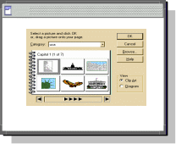
Utility
Service UI
…
Service
…
Service
XXX
Service
Notification
Service
Utility
Service UI
Register
Subscribe
Message
Subscriber
Service
Identity
Service
Contract
Service
All Published
Messages
Drive
Demo
Identity
Check
Check
Usage
Contract
Service
Requestor
Identity
Handler
Contract
Handler
Metering
Request
Handler
Create,
Update,
Query
Data
AXIS
Servlet
Store IdentityKey
In MessageContext
Business
Service
Common
Data
Service
Identity
Handler
SOAP
Message
Metering
Response
Handler
Record Meter
Event
Generate
Report
Utiltiy
Service UI
Metering
Service
Accounting
Service
Get Meter
Events

